Slide 1
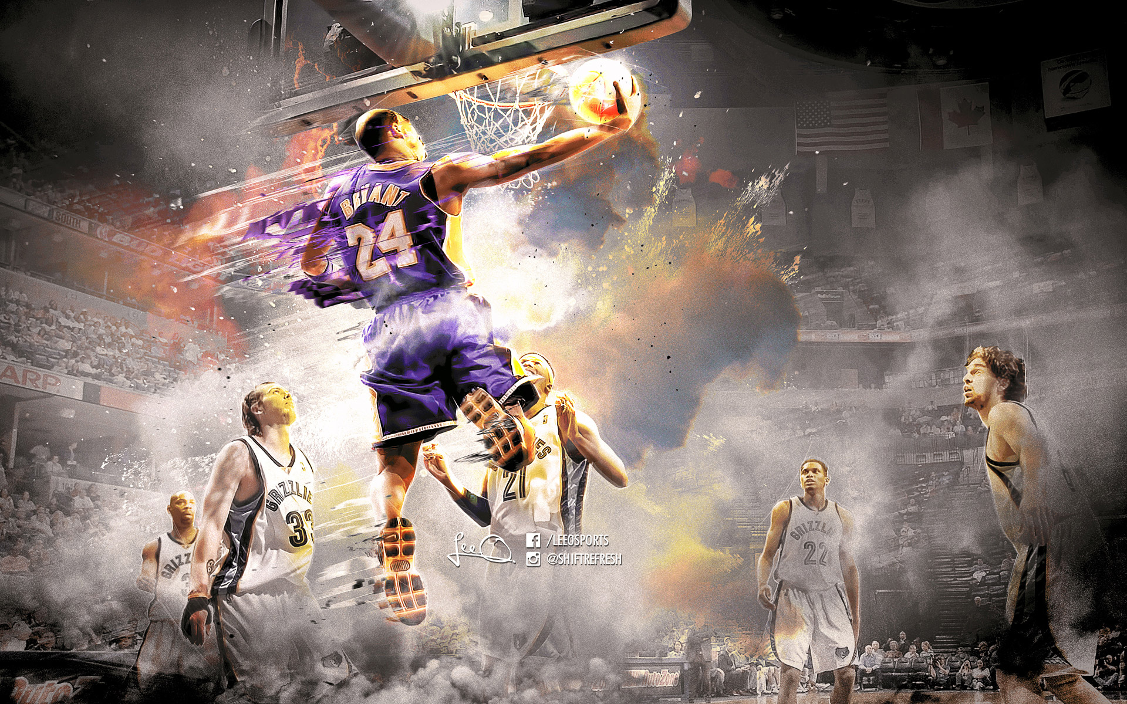
W207 Final Project
Kobe Bryant Shot Selection
August 21, 2017
by Michelle Liu, Surya Nimmagadda, Adhaar Gupta

Slide 2
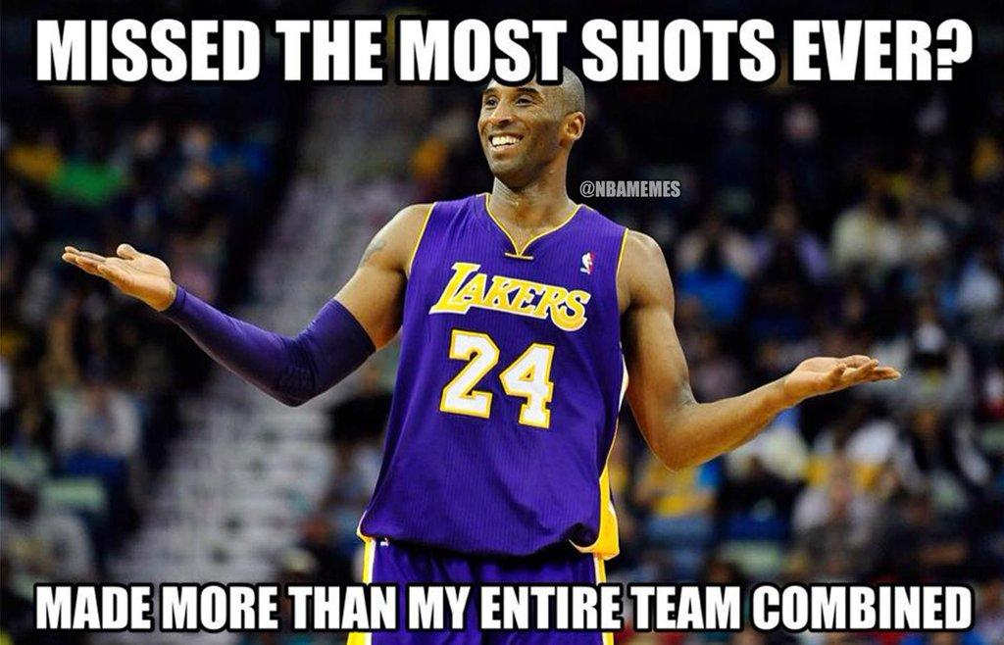
Problem Description
Kobe played his entire 20-year career with Los Angeles Lakers
Set impressive records throughout his NBA career
Career Average of 44.7%
Set the highest record of missed shots
Kaggle's challenge:
Use 20 years of data on Kobe's swishes and misses to predict which shots will miss and which shots will make the net.
Submissions are evaluated on the log loss
Log Loss
Is a measure of the model in terms of certainty than accuracy
The higher the probability of correctly predicting miss/make - the lower the log loss

Slide 3
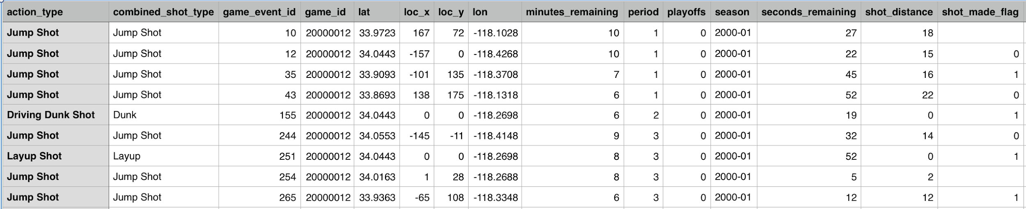
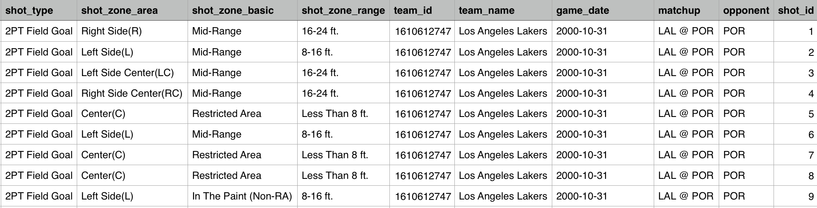
Data

Slide 4
Features
Features analyzed based on our basketball knowledge:
action type
Period
shot zone basic
shot zone area
shot zone range
loc x, loc y
minutes and seconds remaining
shot distance
Playoffs
Season
Game date
Matchup
Notes:
Michelle

Slide 5
Feature Engineering
Dropped
Game event ID, game ID, team name and shot ID are considered irrelevant so we did not include them
Lat and lon are correlated with loc_x and loc_y so we didn't use them
Enhanced
loc x, loc y - transform the coordinates on the basketball court into Gaussian Mixture cluster
action type- 57 unique, binned the 20 least common as Others to reduce this feature
home/away - for matchup feature we derived whether it was a home or away match
Added
minutes and seconds remaining - created a new boolean feature to see if the shot was made in the last 5 seconds of the game
Game date and month - parsed through the game date to get out the date and month of the game
We converted categorical features into numerical for model to interpret
Notes:
Michelle

Slide 6
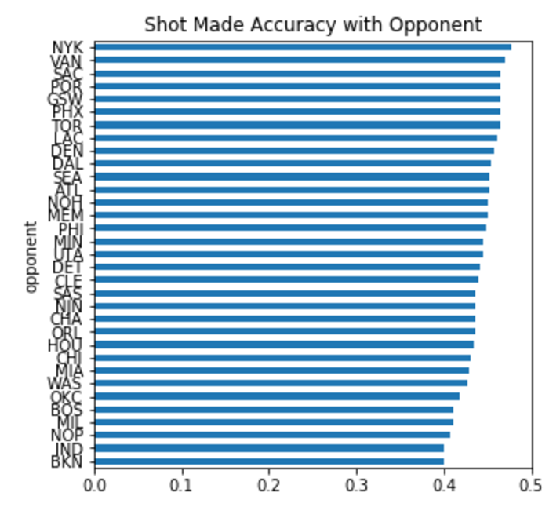
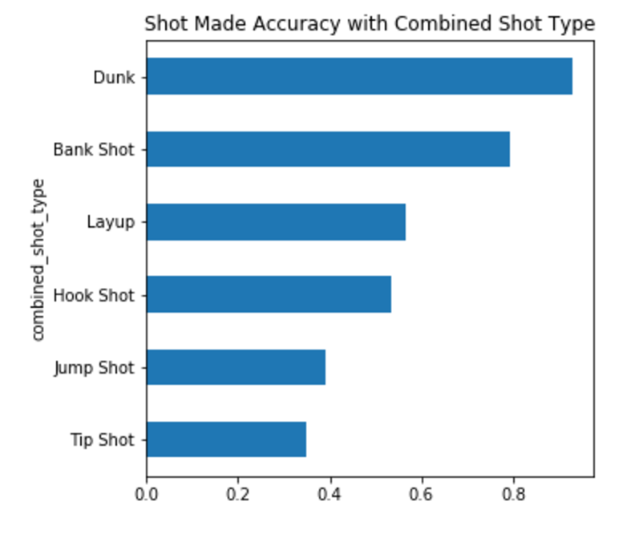
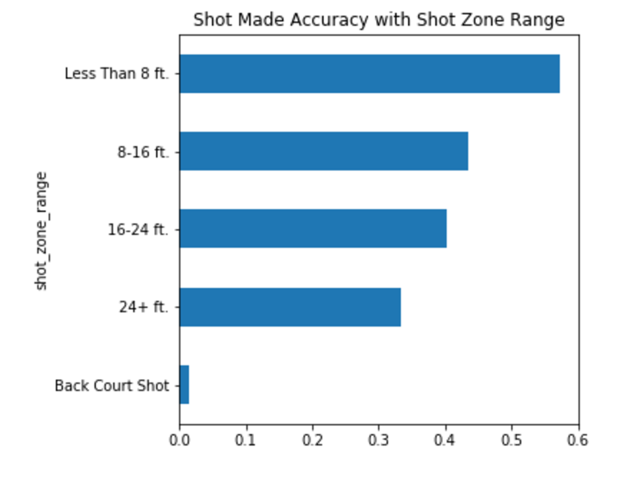
Exploratory Data Analysis
Some examples of EDA we did on the features to determine if we should include them in our models:
Notes:
Michelle

Slide 7
Experimenting with Different Classifiers
Classifier Name | Kaggle Score
KNN classifier | 1.74
Bernoulli NB | 0.941
Gaussian NB | 2.57
Logistic Regression | 0.68
Decision Tree | 17.07
AdaBoost | 0.70
GMM (PCA) | 0.646
Kaggle’s Best Score | 0.565
Notes:
Surya

Slide 8
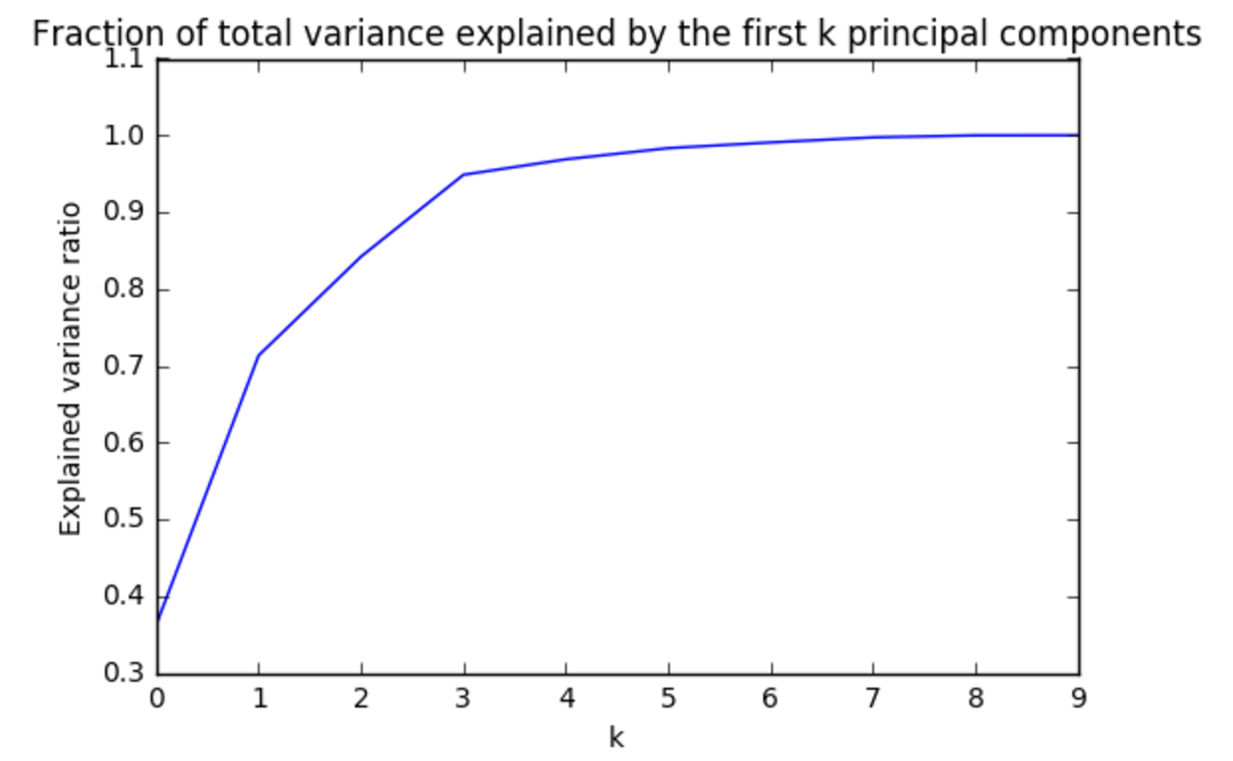
Gaussian Mixture Model
In the training set, some of the data points have high shot probability of either being in or out. So we decided to take the PCA approach
Experimented with multiple GMM component settings to achieve a higher accuracy (to avoid overfitting)
We ended up using 3 PCA components along with 5 GMMs with “full” covariance
Notes:
Adhaar

Slide 9
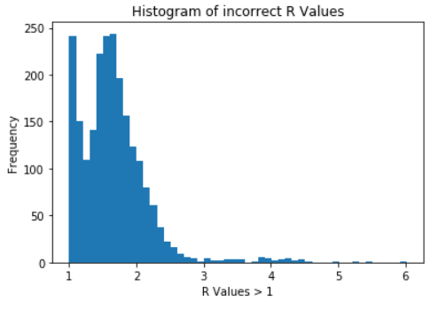
Error Analysis
Method
Shuffle the data and divide into test and train
Run GMM or Logistic Regression
Find the max probability where the prediction is wrong
Look at the data and see if we can find any pattern
Result
Most error occured where we predicted “not in” but the shot was “in”
Most of the extreme cases included the shots that were taken in last 5 seconds
For ~90% of the error, the R factor lied between 1 to 2. That means there was not much difference between the probabilities of in or out.
Notes:
Adhaar

Slide 10
Note Book
Notes:
Adhaar

